Slide 1
Officer Update: Tyger Clerk of the Signet
Princess Æsa feilinn Jossursdottir, OP 31-Aug-2023
(she/her)

Slide 2
It looks like you’re trying to give a Greater Officer update … Wait … didn’t you just step down??
Shhhhh….I’m taking a page out of your book and I’m helping.
Oh…okay then…

Slide 3
Signet Projects
Signet duties are being transitioned! - Complete by end of August (today)
Website update with new officers - Complete
Compiling list of “local practices” or scriptoriums - Complete
New practices to be added as they are organized.
Royal Awards Scheduler - Closed for applications!
Decision will be forthcoming and work with incoming royals for the winter reign.

Slide 4
2023 Overview
Active scribes:
78 scribes as of July 2023 actively taking assignments. This is down 8% from Curia in July 2022, but up from last report
Total scrolls created for 2023:
Mohammad and Corotica (MC22): 221
Brennan and Caoilfhionn (BC23): 181 to date
Backlog:
10 awards added in 2023
7 scrolls completed
96 total awards on the log, less than half are assigned out
♪♪ Stats, Stats, Stats, Stats, Stats, Stats! ♪♪

Slide 5
2023 Overview - Notable trends
90s FASHION IS HIP AND COOL AGAIN!
Where are my flannel plaid shirts when I need them?
NOT THOSE KIND OF TRENDS!!!!
I think I have a wallet chain around here somewhere…
Seriously, can you focus for a hot minute?!

Slide 6
2023 Overview - Notable trends
Scheduling:
Events not on the EK calendar with enough lead time for scrolls (need at least 8 weeks)
Locals writing in folks too late for local events
Wanting “big events” vs local or smaller events (ie. GNEW, Pennsic, Birka, Mudthaw).
Communication:
Recommendations not written with enough detail for scheduler to figure out a contact
Award contact taking a long time to get back to scheduler
Adding too many folks into the conversation. Should be main contact and scheduler to facilitate on emails.
Recommendations:
“The Crown said so” or “Well, duh” are not great recommendations! Scribes use this info to craft words for the scrolls. Don’t make our job harder!
Don’t use flowery or overly long intro/signature sentences. Keep it concise and factual. It’s about the recipient, not the recommender.

Slide 7
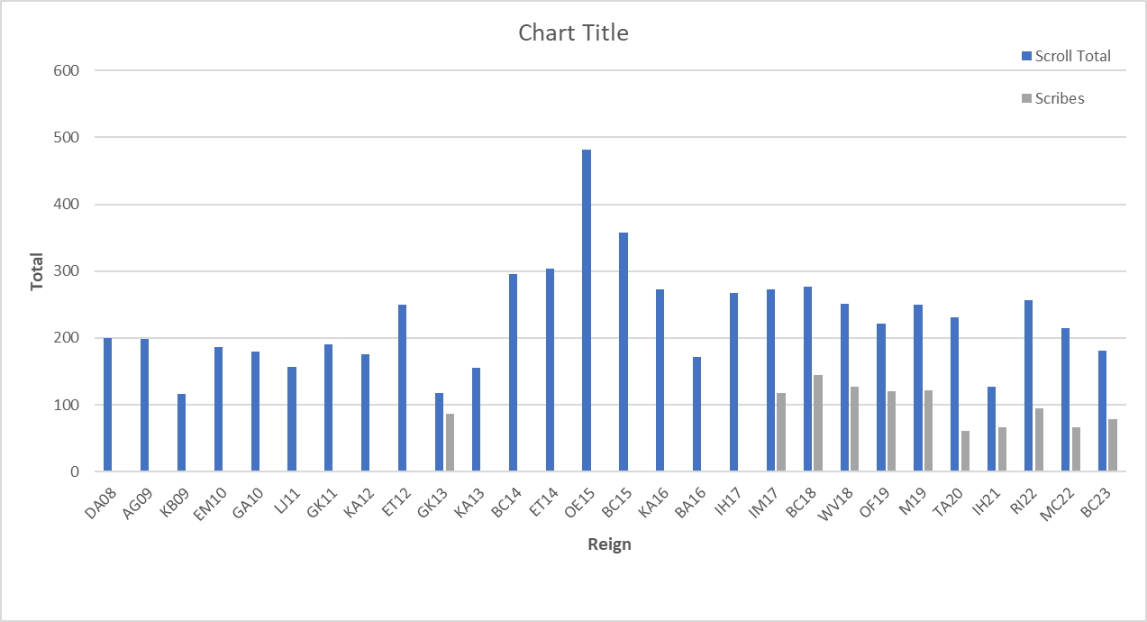
Historical Scroll Creation Totals (2008 to present)
BEHOLD!
My data!
Gaze upon it and despair!
Average scrolls/reign = 226 (-3)
That is some sexy looking data right there!
= Creation of the ”silver” awards
= extended reign time due to pandemic

Slide 8
Helpful reminders for everyone!
What can the populace do to help, Feilinn?
Great question, Sparky! Here’s a helpful guide:
DO:
Communicate with the Signet’s office regarding scrolls.
Give grace and courtesy to your volunteers.
Always email Signet Staff via our official emails.
Ask how you can help.
DON’T:
Assign out a scroll to a scribe yourself. This means do not bug your scribal friends to “volunteer”.
Assume a slight if your scroll is late or a deadline is missed.
Message Signet Staff on FB, we likely won’t see it.

Slide 9
In Conclusion:
I hope everyone has enjoyed my Signet presentations over the years. My goal here was to inform, educate, and get a little laugh out of folks.
I mean…I certainly enjoyed it, but what will I do now?
I think I have an idea….
Oh???

Slide 10
Hi! I’m Camille, the new Signet. I’m just getting started and may need some assistance with this whole thing …
OH! I can help with that!

Slide 11
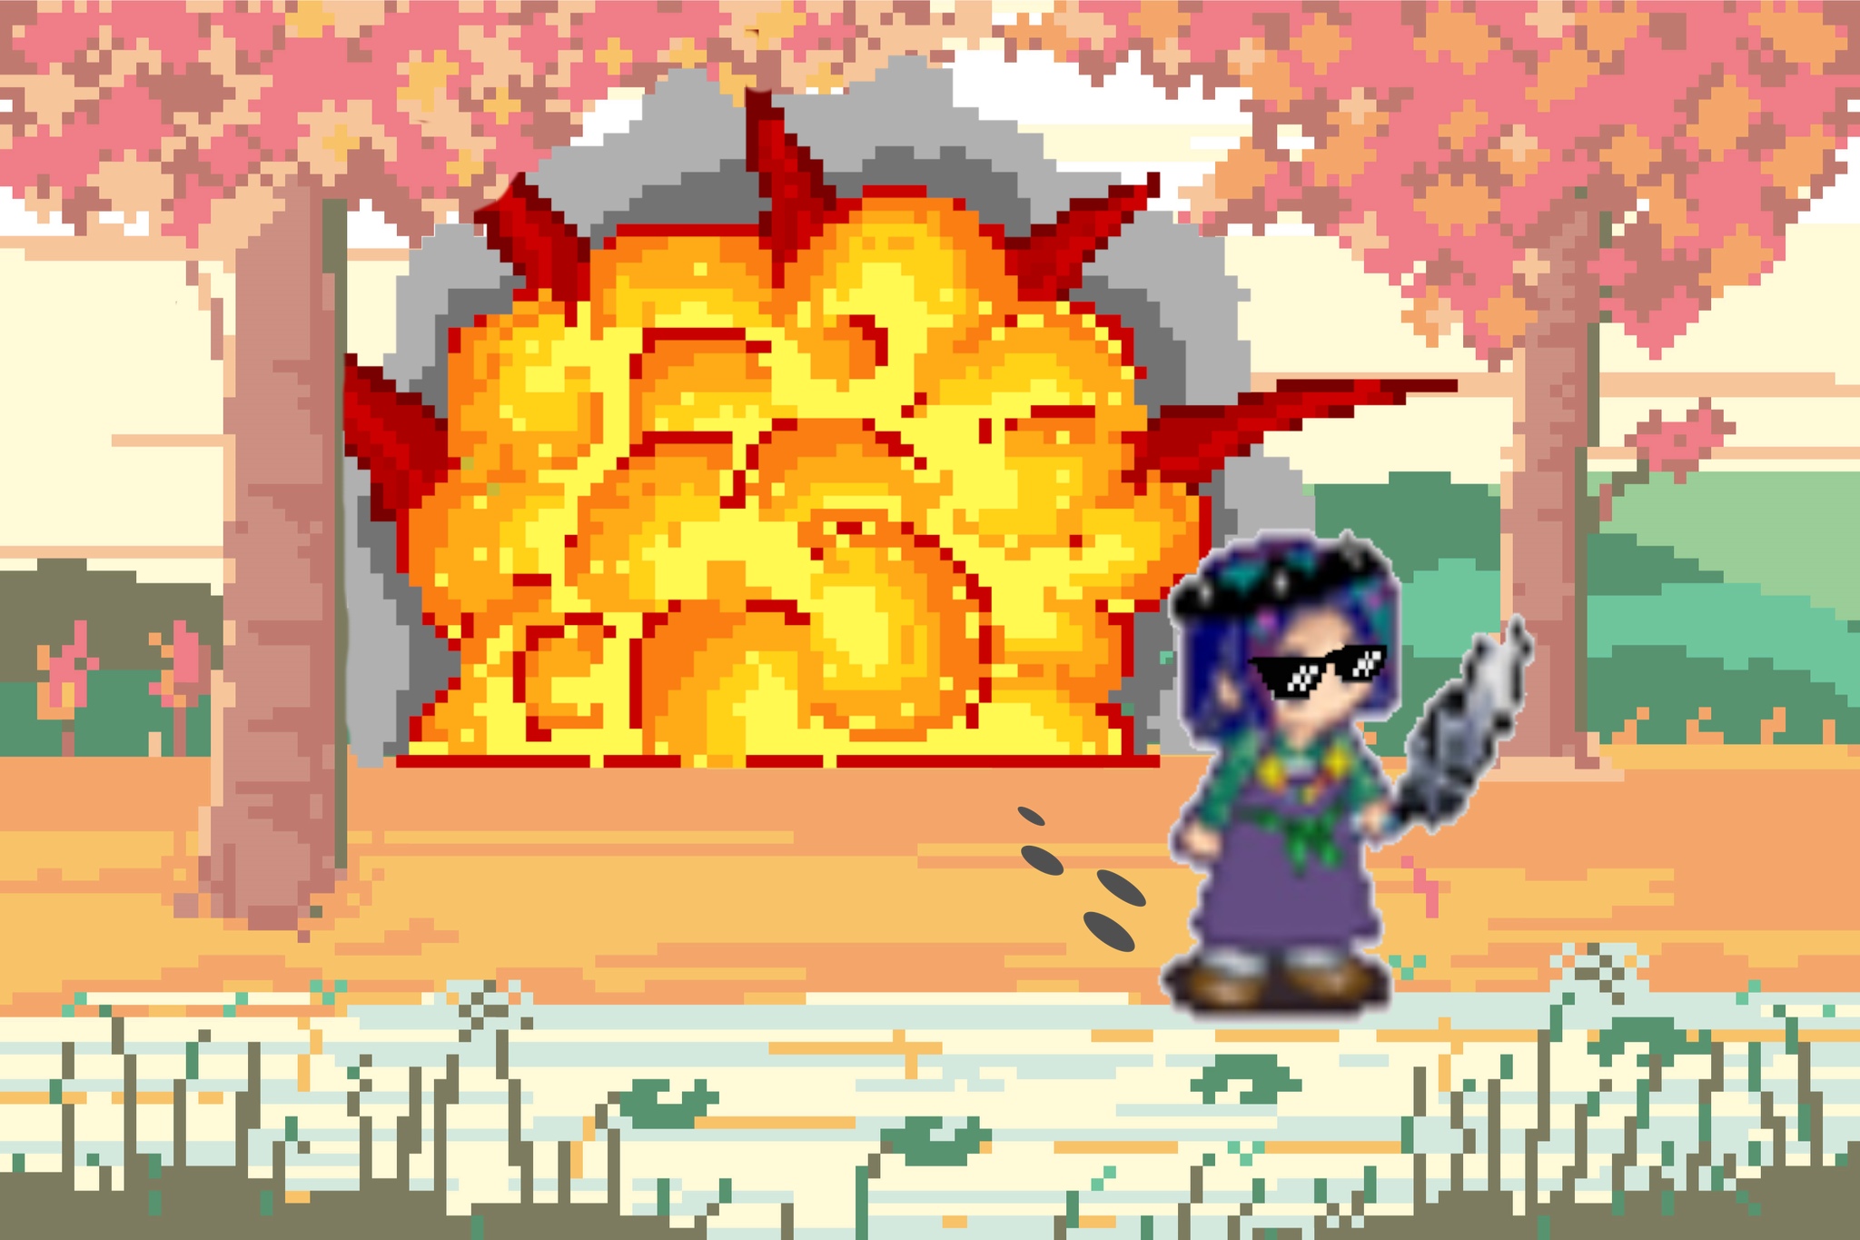
THE END
This is ya Princess from Boston signing out, friends!
LET’S GO, EAST KINGDOM!

